Slide 1
Project Presentation #4
Team E: Jiayu Yao, Shang Liu, Yuqiao Han

Slide 2
Goals
Features
Analyze factors that highly affect on Youtube video popularity.
Find out the top ten rules and attributes that contribute to high views on YouTube.
Input() features:
"channel frequency", "contain_facebook", "contain_instagram",
"tags_length", "daily_likes", "daily_dislikes", "daily_comment_count",
"title_length", "title_has_num", "title_has_special"
Output features:
"daily_views"

Slide 3
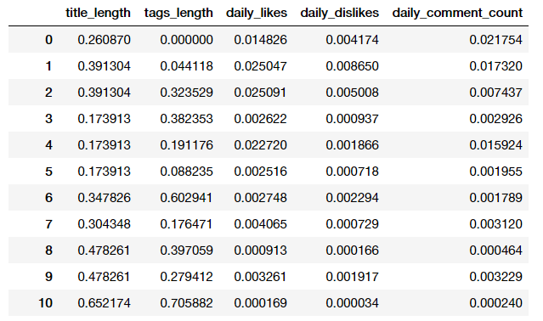
Feature Normalization

Slide 4
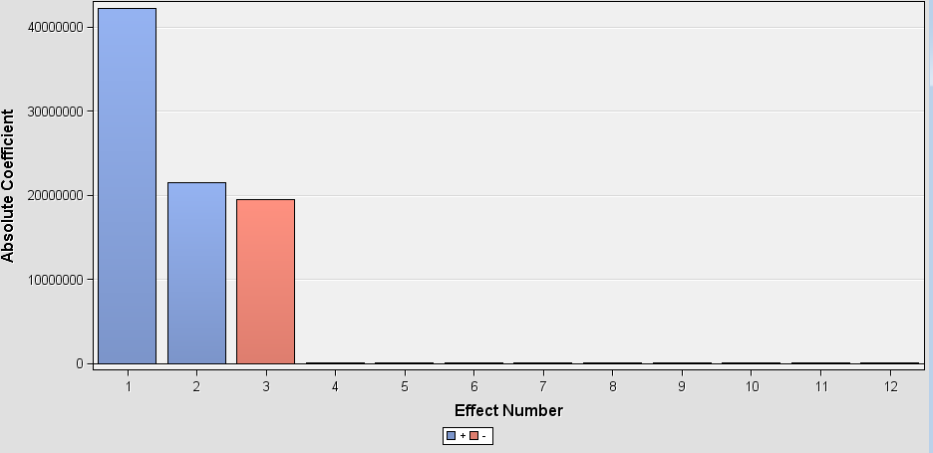
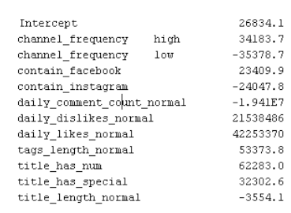
Linear Regression

Slide 5
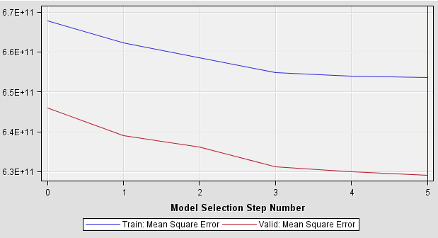
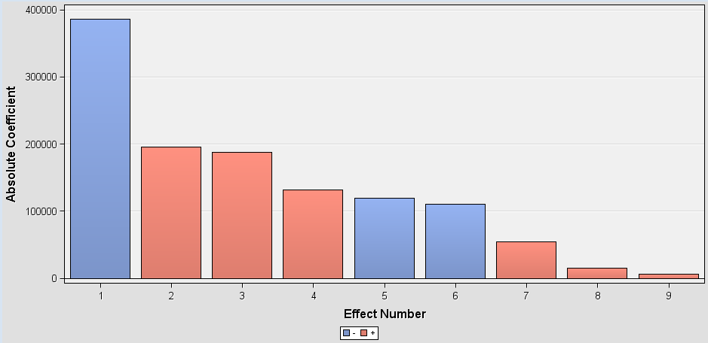
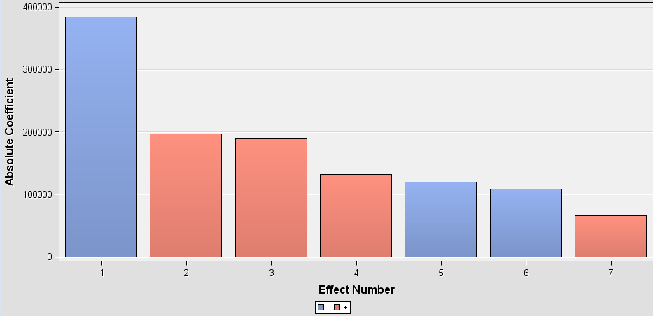
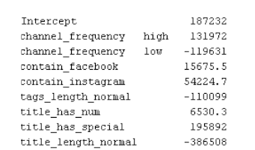
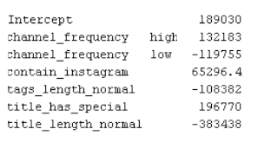
Linear Regression
no feature model selection
feature model selection

Slide 6
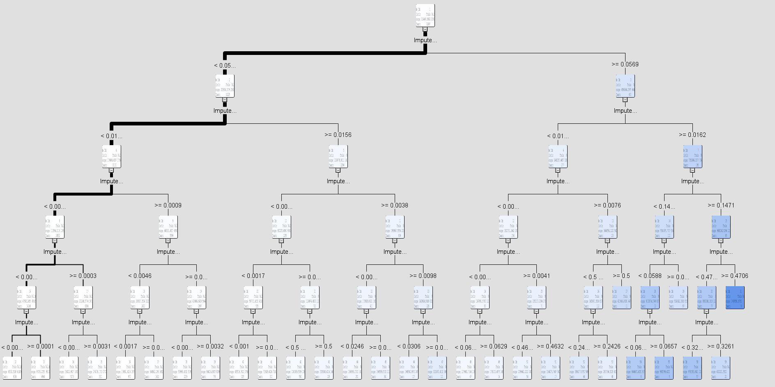
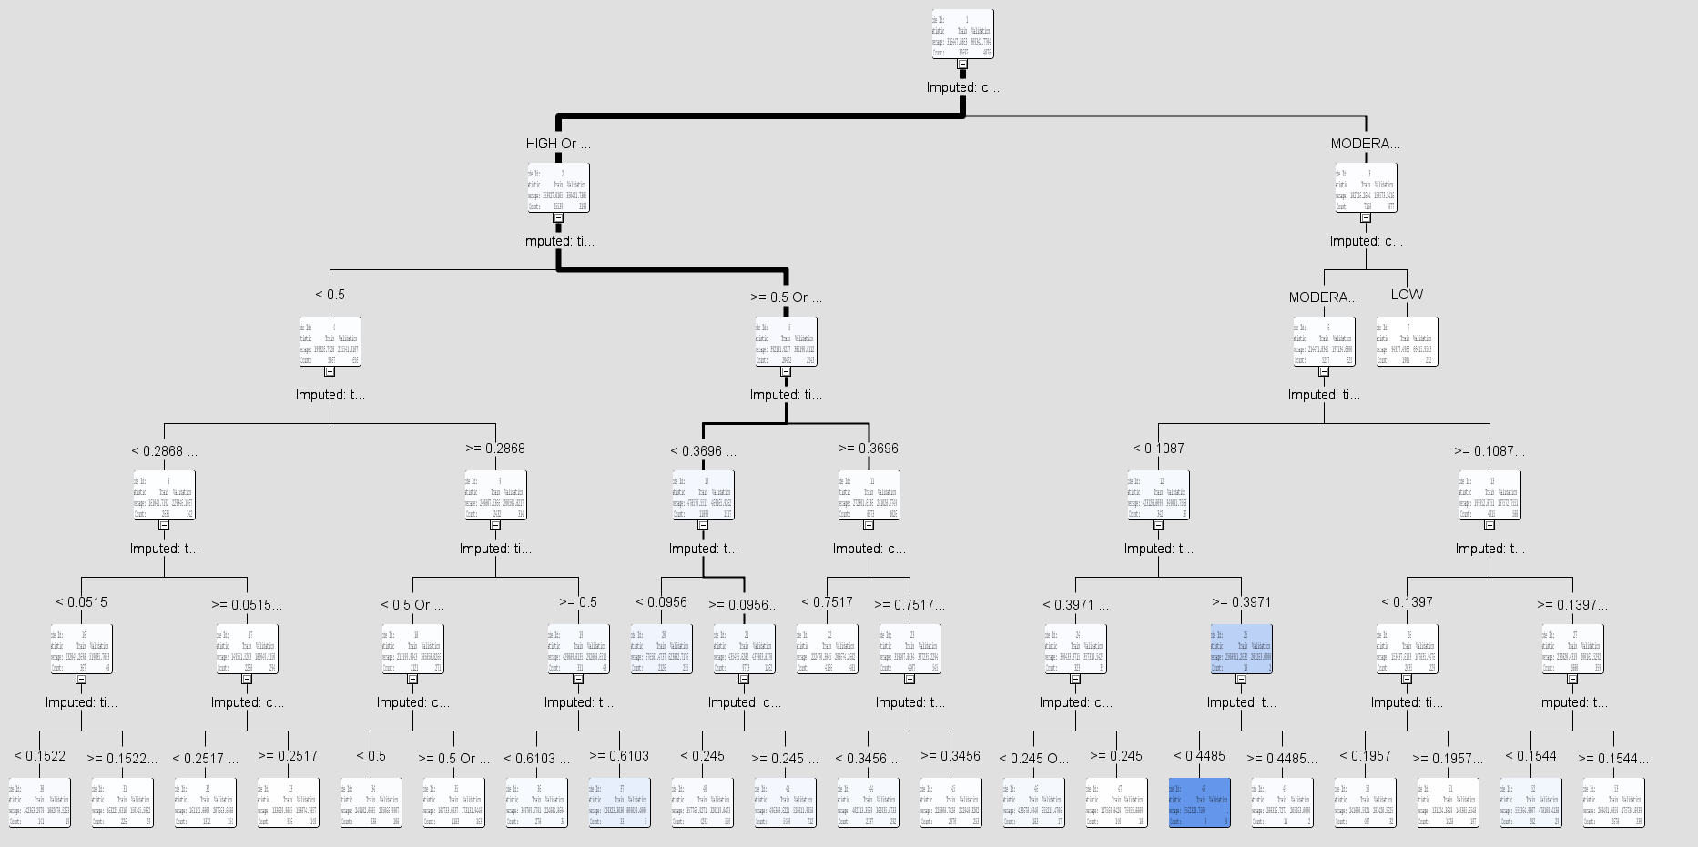
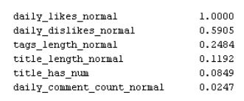
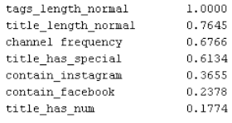
Decision Tree max:5

Slide 7
Decision Tree

Slide 8
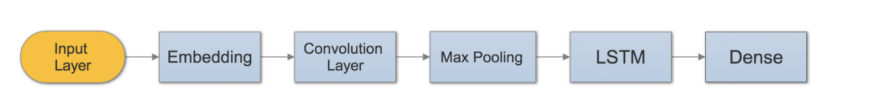
Exploration of Tag Words & Title
Current Proposed Model:
In order to investigate the word order of tags and title that related to the daily view count, we are proposing to establish neural network to analyze word embedding. Current plan is to create a LSTM architecture and train the model to see the relation between word order and view counts.
A fairly standard network NLP tasks:

